Slide 1
CSS LISTS

Slide 2
LISTS
We have the following five CSS properties, which can be used to control lists:
The list-style-type allows you to control the shape or appearance of the marker.
The list-style-position specifies whether a long point that wraps to a second line should align with the first line or start underneath the start of the marker.

Slide 3
LISTS
The list-style-image specifies an image for the marker rather than a bullet point or number.
The list-style serves as shorthand for the preceding properties.
The marker-offset specifies the distance between a marker and the text in the list.
Now we will see how to use these properties with examples.

Slide 4
The list-style-type Property
The list-style-type property allows you to control the shape or style of a bullet point (also known as a marker) in case of unordered lists and the style of numbering characters in ordered lists.
Here are the values, which can be used for an unordered list:

Slide 5
The list-style-type Property
None
NA
disc (default)
A filled-in circle
Circle
An empty circle
Square
A filled-in square

Slide 6
The list-style-type Property
Here are the values, which can be used for an ordered list:
Decimal
Number
1,2,3,4,5
decimal-leading-zero
0 before the number
01, 02, 03, 04, 05

Slide 7
The list-style-type Property
lower-alpha
Lowercase alphanumeric characters
a, b, c, d, e
upper-alpha
Uppercase alphanumeric characters
A, B, C, D, E
lower-roman
Lowercase Roman numerals
i, ii, iii, iv, v
upper-latin
The marker is upper-latin
A, B, C, D, E

Slide 8
The list-style-type Property
upper-roman
Uppercase Roman numerals
I, II, III, IV, V
lower-greek
The marker is lower-greek
alpha, beta, gamma
lower-latin
The marker is lower-latin
a, b, c, d, e

Slide 9
The list-style-type Property
hebrew
The marker is traditional Hebrew numbering
armenian
The marker is traditional Armenian numbering
georgian
The marker is traditional Georgian numbering
cjk-ideographic
The marker is plain ideographic numbers

Slide 10
The list-style-type Property
hiragana
The marker is hiragana
a, i, u, e, o, ka, ki
katakana
The marker is katakana
A, I, U, E, O, KA, KI
hiragana-iroha
The marker is hiragana-iroha
i, ro, ha, ni, ho, he, to
katakana-iroha
The marker is katakana-iroha
I, RO, HA, NI, HO, HE, TO

Slide 11
The list-style-type Property
Here is an example:
<ul style="list-style-type:circle;">
<li>Maths</li>
<li>Social Science</li>
<li>Physics</li>
</ul>

Slide 12
The list-style-type Property
<ul style="list-style-type:square;">
<li>Maths</li>
<li>Social Science</li>
<li>Physics</li>
</ul>

Slide 13
The list-style-type Property
<ol style="list-style-type:decimal;">
<li>Maths</li>
<li>Social Science</li>
<li>Physics</li>
</ol>

Slide 14
The list-style-type Property
<ol style="list-style-type:lower-alpha;">
<li>Maths</li>
<li>Social Science</li>
<li>Physics</li>
</ol>

Slide 15
The list-style-type Property
<ol style="list-style-type:lower-roman;">
<li>Maths</li>
<li>Social Science</li>
<li>Physics</li>
</ol>

Slide 16
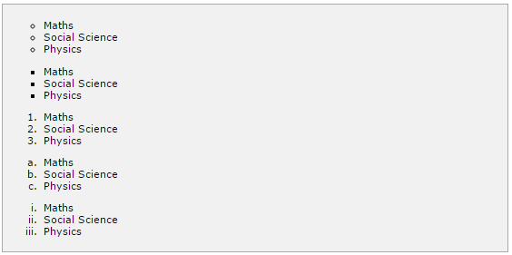
The list-style-type Property

Slide 17
The list-style-position Property
The list-style-position property indicates whether the marker should appear inside or outside of the box containing the bullet points.
It can have one of the two values:

Slide 18
The list-style-position Property
inside
If the text goes onto a second line, the text will wrap underneath the marker.
It will also appear indented to where the text would have started if the list had a value of outside.
outside
If the text goes onto a second line, the text will be aligned with the start of the first line (to the right of the bullet).

Slide 19
The list-style-position Property
<ul style="list-style-type:circle; list-stlye-position:outside;">
<li>Maths</li>
<li>Social Science</li>
<li>Physics</li>
</ul>

Slide 20
The list-style-position Property
<ul style="list-style-type:square;list-style-position:inside;">
<li>Maths</li>
<li>Social Science</li>
<li>Physics</li>
</ul>

Slide 21
The list-style-position Property
<ol style="list-style-type:decimal;list-stlye-position:outside;">
<li>Maths</li>
<li>Social Science</li>
<li>Physics</li>
</ol>

Slide 22
The list-style-position Property
<ol style="list-style-type:lower-alpha;list-style-position:inside;">
<li>Maths</li>
<li>Social Science</li>
<li>Physics</li>
</ol>

Slide 23
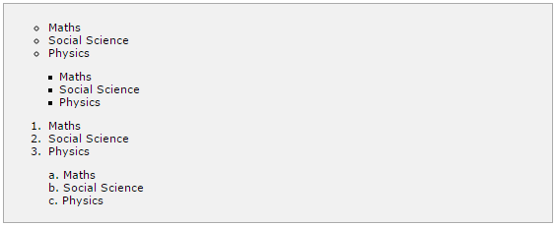
The list-style-position Property

Slide 24
The list-style-image Property
The list-style-image allows you to specify an image so that you can use your own bullet style.
The syntax is similar to the background-image property with the letters url starting the value of the property followed by the URL in brackets.
If it does not find the given image then default bullets are used.

Slide 25
The list-style-image Property
<ul>
<li style="list-style-image: url(/images/bullet.gif);">Maths</li>
<li>Social Science</li>
<li>Physics</li>
</ul>

Slide 26
The list-style-image Property
<ol>
<li style="list-style-image: url(/images/bullet.gif);">Maths</li>
<li>Social Science</li>
<li>Physics</li>
</ol>

Slide 27
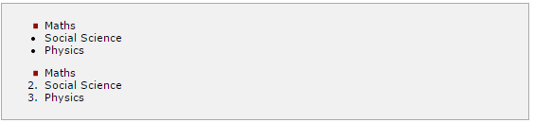
The list-style-image Property
It will produce the following result:

Slide 28
Thelist-style Property
The list-style allows you to specify all the list properties into a single expression.
These properties can appear in any order.

Slide 29
Thelist-style Property
<ul style="list-style: inside square;">
<li>Maths</li>
<li>Social Science</li>
<li>Physics</li>
</ul>

Slide 30
Thelist-style Property
<ol style="list-style: outside upper-alpha;">
<li>Maths</li>
<li>Social Science</li>
<li>Physics</li>
</ol>

Slide 31
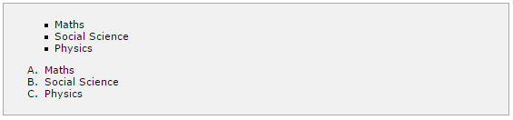
Thelist-style Property
It will produce the following result:

Slide 32
The marker-offset Property
The marker-offset property allows you to specify the distance between the marker and the text relating to that marker.
Its value should be a length as shown in the following example:
Unfortunately, this property is not supported in IE 6 or Netscape 7.
Here is an example:

Slide 33
The marker-offset Property
<ul style="list-style: inside square; marker-offset:2em;">
<li>Maths</li>
<li>Social Science</li>
<li>Physics</li>
</ul>

Slide 34
The marker-offset Property
<ol style="list-style: outside upper-alpha; marker-offset:2cm;">
<li>Maths</li>
<li>Social Science</li>
<li>Physics</li>
</ol>

Slide 35
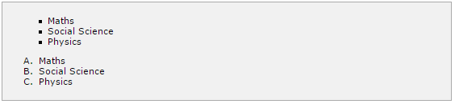
The marker-offset Property
It will produce the following result:

Slide 36
PADDINGS
The padding property allows you to specify how much space should appear between the content of an element and its border:
The value of this attribute should be either a length, a percentage, or the word inherit.
If the value is inherit, it will have the same padding as its parent element.
If a percentage is used, the percentage is of the containing box.

Slide 37
PADDINGS
The following CSS properties can be used to control lists.
You can also set different values for the padding on each side of the box using the following properties:

Slide 38
PADDINGS
The padding-bottom specifies the bottom padding of an element.
The padding-top specifies the top padding of an element.
The padding-left specifies the left padding of an element.
The padding-right specifies the right padding of an element.
The padding serves as shorthand for the preceding properties.

Slide 39
The padding-bottom Property
The padding-bottom property sets the bottom padding (space) of an element.
This can take a value in terms of length of %.
Here is an example:

Slide 40
The padding-bottom Property
<p style="padding-bottom: 15px; border:1px solid black;">
This is a paragraph with a specified bottom padding
</p>
<p style="padding-bottom: 5%; border:1px solid black;">
This is another paragraph with a specified bottom padding in percent
</p>

Slide 41
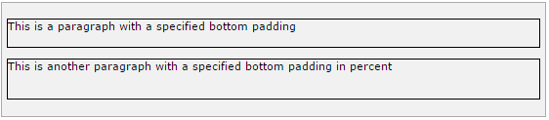
The padding-bottom Property
It will produce the following result:

Slide 42
The padding-top Property
The padding-top property sets the top padding (space) of an element.
This can take a value in terms of length of %.
Here is an example:

Slide 43
The padding-top Property
<p style="padding-top: 15px; border:1px solid black;">
This is a paragraph with a specified top padding
</p>
<p style="padding-top: 5%; border:1px solid black;">
This is another paragraph with a specified top padding in percent
</p>

Slide 44
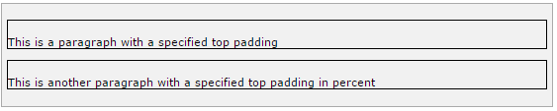
The padding-top Property
It will produce the following result:

Slide 45
The padding-left Property
The padding-left property sets the left padding (space) of an element.
This can take a value in terms of length of %.
Here is an example:

Slide 46
The padding-left Property
<p style="padding-left: 15px; border:1px solid black;">
This is a paragraph with a specified left padding
</p>
<p style="padding-left: 15%; border:1px solid black;">
This is another paragraph with a specified left padding in percent
</p>

Slide 47

The padding-left Property
It will produce the following result:

Slide 48
The padding-right Property
The padding-right property sets the right padding (space) of an element.
This can take a value in terms of length of %.
Here is an example:

Slide 49
The padding-right Property
<p style="padding-right: 15px; border:1px solid black;">
This is a paragraph with a specified right padding
</p>
<p style="padding-right: 5%; border:1px solid black;">
This is another paragraph with a specified right padding in percent
</p>

Slide 50

The padding-right Property
It will produce the following result:

Slide 51
The Padding Property
The padding property sets the left, right, top and bottom padding (space) of an element.
This can take a value in terms of length of %.
Here is an example:

Slide 52
The Padding Property
<p style="padding: 15px; border:1px solid black;">
all four padding will be 15px
</p>
<p style="padding:10px 2%; border:1px solid black;">
top and bottom padding will be 10px, left and right padding will be 2% of the total width of the document.
</p>

Slide 53
The Padding Property
<p style="padding: 10px 2% 10px; border:1px solid black;">
top padding will be 10px, left and right padding will be 2% of the total width of the document, bottom padding will be 10px
</p>

Slide 54
The Padding Property
<p style="padding: 10px 2% 10px 10px; border:1px solid black;">
top padding will be 10px, right padding will be 2% of the total width of the document, bottom padding and top padding will be 10px
</p>

Slide 55
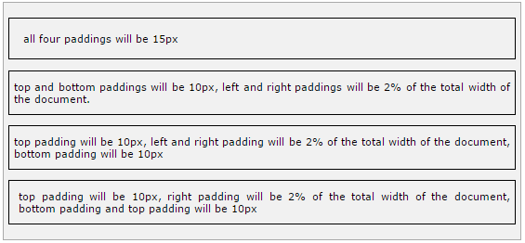
The Padding Property
It will produce the following result:

Slide 56
CURSORS
The cursor property of CSS allows you to specify the type of cursor that should be displayed to the user.

Slide 57
CURSORS
One good usage of this property is in using images for submit buttons on forms.
By default, when a cursor hovers over a link, the cursor changes from a pointer to a hand.
However, it does not change form for a submit button on a form.
Therefore, whenever someone hovers over an image that is a submit button, it provides a visual clue that the image is clickable.

Slide 58
CURSORS
the possible values for the cursor property:
auto
Shape of the cursor depends on the context area it is over.
For example, an ‘I’ over text, a ‘hand’ over a link, and so on.
crosshair
A crosshair or plus sign.

Slide 59
CURSORS
default
An arrow.
pointer
A pointing hand (in IE 4 this value is hand).
move
The ‘I’ bar.
e-resize
The cursor indicates that an edge of a box is to be moved right (east).

Slide 60
CURSORS
ne-resize
The cursor indicates that an edge of a box is to be moved up and right (north/east).
nw-resize
The cursor indicates that an edge of a box is to be moved up and left (north/west).
n-resize
The cursor indicates that an edge of a box is to be moved up (north).

Slide 61
CURSORS
se-resize
The cursor indicates that an edge of a box is to be moved down and right (south/east).
sw-resize
The cursor indicates that an edge of a box is to be moved down and left (south/west).
s-resize
The cursor indicates that an edge of a box is to be moved down (south).

Slide 62
CURSORS
w-resize
The cursor indicates that an edge of a box is to be moved left (west).
text
The I bar.
wait
An hour glass.
help
A question mark or balloon, ideal for use over help buttons.
<url>
The source of a cursor image file.

Slide 63
CURSORS
NOTE: You should try to use only these values to add helpful information for users, and in places, they would expect to see that cursor.
For example, using the crosshair when someone hovers over a link can confuse the visitors.
Here is an example:

Slide 64
CURSORS
<p>Move the mouse over the words to see the cursor change:</p>
<div style="cursor:auto">Auto</div>
<div style="cursor:crosshair">Crosshair</div>
<div style="cursor:default">Default</div>
<div style="cursor:pointer">Pointer</div>
<div style="cursor:move">Move</div>
<div style="cursor:e-resize">e-resize</div>
<div style="cursor:ne-resize">ne-resize</div>
<div style="cursor:nw-resize">nw-resize</div>

Slide 65
CURSORS
<div style="cursor:n-resize">n-resize</div>
<div style="cursor:se-resize">se-resize</div>
<div style="cursor:sw-resize">sw-resize</div>
<div style="cursor:s-resize">s-resize</div>
<div style="cursor:w-resize">w-resize</div>
<div style="cursor:text">text</div>
<div style="cursor:wait">wait</div>
<div style="cursor:help">help</div>

Slide 66
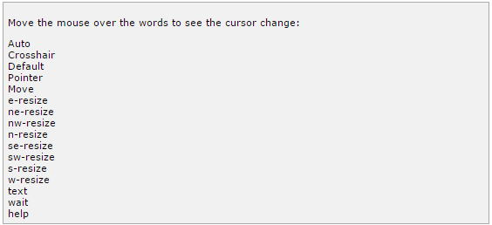
CURSORS
It will produce the following result:

